Slide 1








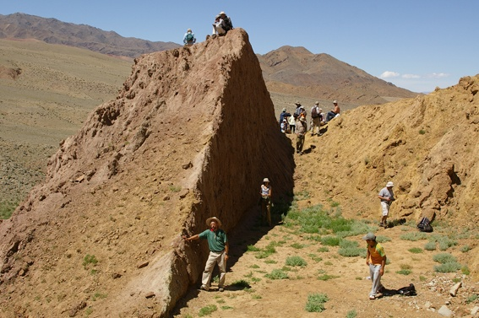
ANSO–MAS 2026 | THE SECOND INTERNATIONAL CONFERENCE ON ENVIRONMENTAL HAZARD IN ASIA
Building Resilience to Future Hazards
Seismic source model
for seismic hazard analysis
of Mongolia
Earthquake catalogues, seismotectonic, and active faults
as input for probabilistic seismic hazard analysis
Ankhtsetseg Dorjsuren (ankhaa@iag.ac.mn)
Mungunsuren D., Odonbaatar Ch., Dembereldulam M., Baatarsuren G.
Institute of Astronomy and Geophysics, Mongolian Academy of Sciences
29 July 2026 • Ulaanbaatar, Mongolia
IAG Mongolia • ANSO–MAS 2026

Slide 2
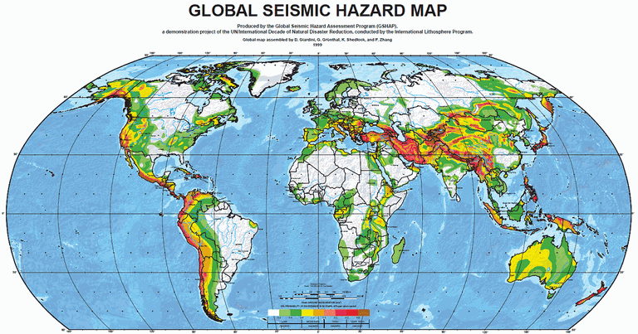
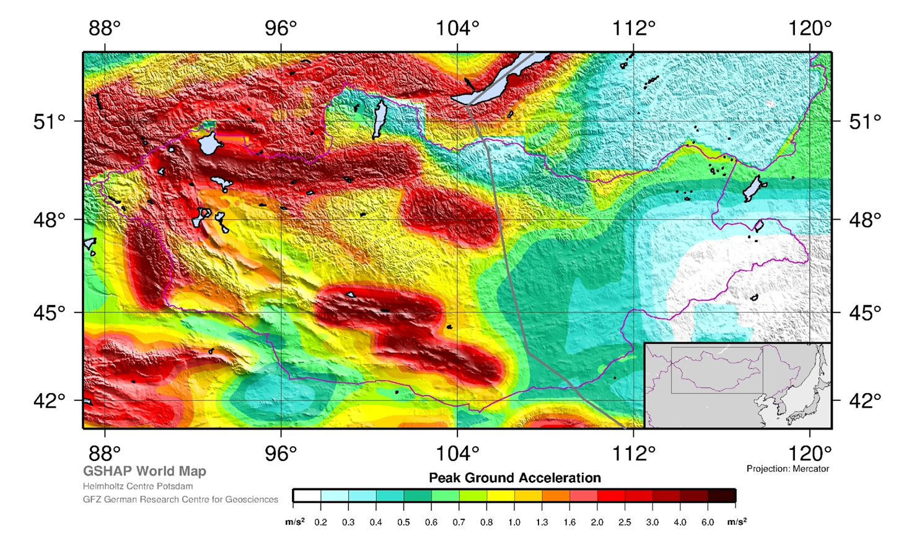
HAZARD CONTEXT
02
GSHAP provides the regional seismic-hazard context for Mongolia
REGIONAL PGA PATTERN
The mapped PGA is not uniform across Mongolia.
Higher mapped PGA is concentrated mainly in western and central Mongolia, while much of the east is lower.
A national source model is needed to represent distributed seismicity and mapped active faults.
IAG Mongolia • ANSO–MAS 2026
Source: GSHAP World Map, GFZ Potsdam • PGA in m/s²

Slide 3
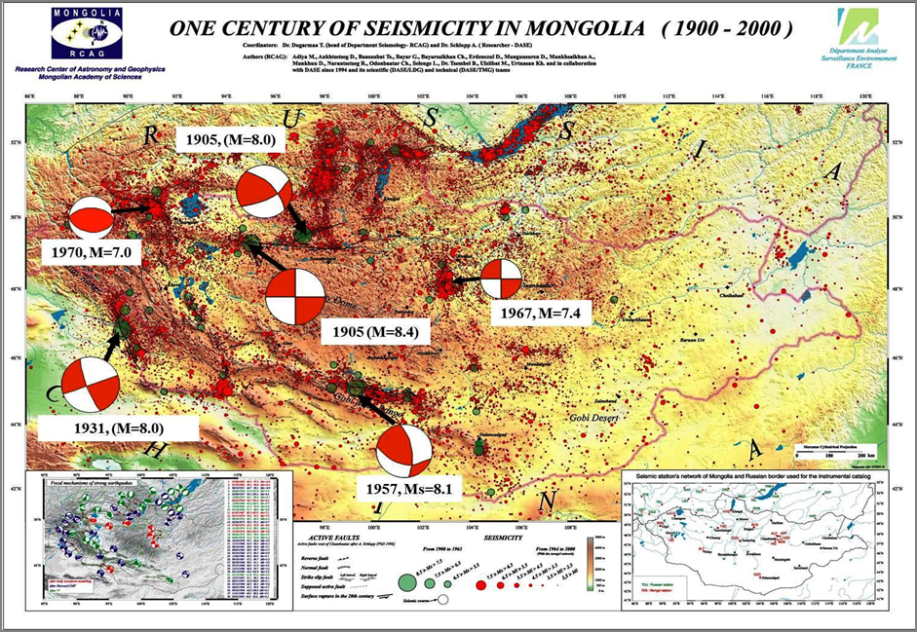
WHY THIS MATTERS
Large earthquakes are well documented in Mongolia
03
Why the source model is needed
Large events are infrequent,
but their consequences can be severe.
Critical infrastructure increasingly extends across regions with unequal monitoring and fault evidence.
Hazard analysis must therefore represent both observed seismicity and geologically plausible ruptures.
CATALOGUE + GEOLOGY
Source map: Antoine Schlupp, Adija, M., et al. "One century of seismicity in Mongolia (1900–2000)." Scientific (DASE/LDG) and technical (DASE/TMG) teams, Research Centre of Astronomy & Geophysics of the Mongolian Academy of Sciences, Mongolia, and Laboratoire de Télédétection et Risque Sismique, France (2003)
IAG Mongolia • ANSO–MAS 2026

Slide 4
MODEL QUESTION
The source model defines four quantities required by PSHA
04
WHERE?
HOW OFTEN?
HOW LARGE?
HOW?
Potential earthquakes
can originate
Events recur across
magnitude ranges
Sources have physical
magnitude limits
Rupture geometry
controls shaking
The available observations are converted into explicit source parameters for PSHA.
IAG Mongolia • ANSO–MAS 2026
Source: Jack Baker, Seismic Hazard and Risk Analysis

Slide 5
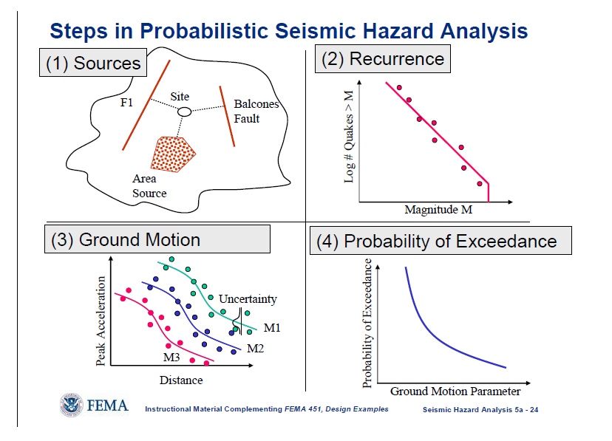
HYBRID REPRESENTATION
The model includes area sources and fault sources
05
AREA SOURCES
FAULT SOURCES
Distributed seismicity
Mapped rupture potential
• Geometry follows mapped active faults
• Inclusion requires evidence of recent tectonic activity
• Represents localized rupture and its physical source dimensions
• Boundaries follow earthquake distribution and tectonic coherence
• Gutenberg–Richter a- and b-values describe activity and magnitude recurrence
• Represents sources where individual faults are uncertain or unresolved
Area sources provide regional coverage; fault sources represent mapped ruptures.
IAG Mongolia • ANSO–MAS 2026
Source: Jack Baker, Seismic Hazard and Risk Analysis

Slide 6
AREA-SOURCE CHARACTERIZATION
Gutenberg–Richter parameters define earthquake occurrence rates
06
Gutenberg–Richter relation
Scientific controls
log₁₀ N(M ≥ m) = a − bm
1 Catalogue completeness
2 Magnitude homogenization
3 Zone-boundary sensitivity
4 Parameter uncertainty
5 Maximum-magnitude assumptions
a → overall activity rate
b → relative proportion of small and large events
N → expected number above magnitude m
The parameters depend on catalogue completeness, magnitude range, and zone geometry.
IAG Mongolia • ANSO–MAS 2026
Source: Jack Baker, Seismic Hazard and Risk Analysis

Slide 7
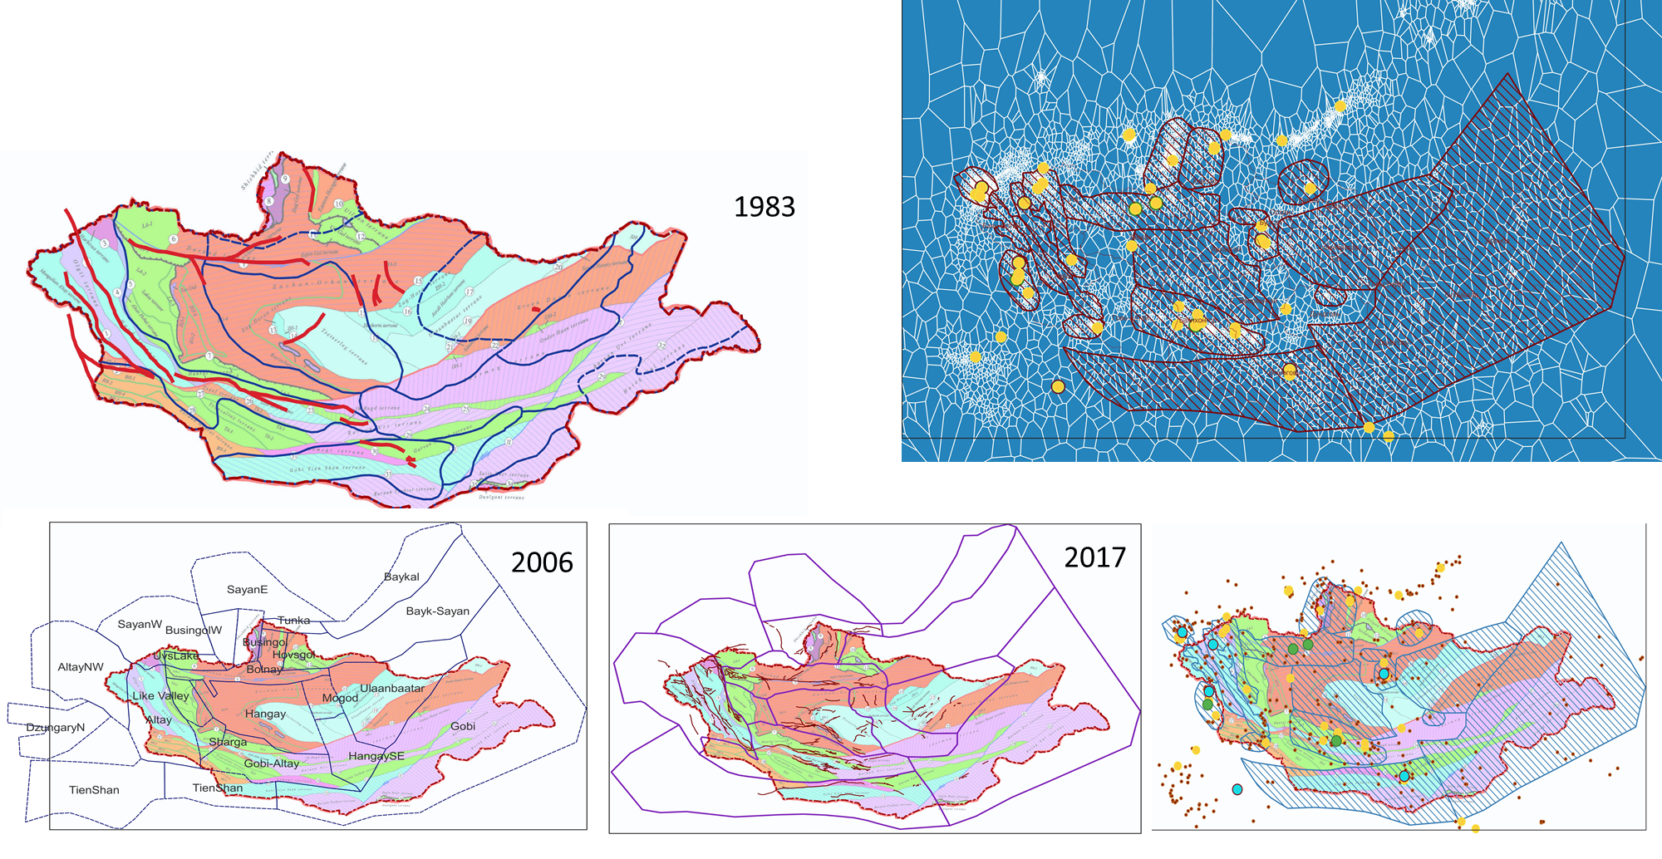
EVIDENCE BASE
04
EVIDENCE BASE
04
Four evidence streams constrain the national model
07
Source-zone boundaries were revised as new data became available
Earthquake catalogues
Geology
01
02
MODEL EVIDENCE
Spatial patterns, magnitude–frequency behaviour
01
Earthquake catalogues
Quaternary deformation and mapped structures
02
Seismotectonic model
Tectonics
Active-fault studies
03
04
03
Active-fault studies
Regional stress and structural context
Recent displacement and rupture evidence
The final boundaries reflect the combined seismological and geological evidence.
Historical model development: 1983-Khilko et al; 2006-SHA of capital Ulaanbaatar;
The boundaries were updated using earthquake catalogues, geological information, and active-fault studies.
Interpretation is strongest where independent evidence converges.
IAG Mongolia • ANSO–MAS 2026
Source: O. Tomurtogoo, ed., 2003, Tectonic map of Mongolia: Mongolian Academy of Sciences, scale 1:1,000,000.
IAG Mongolia • ANSO–MAS 2026

Slide 8
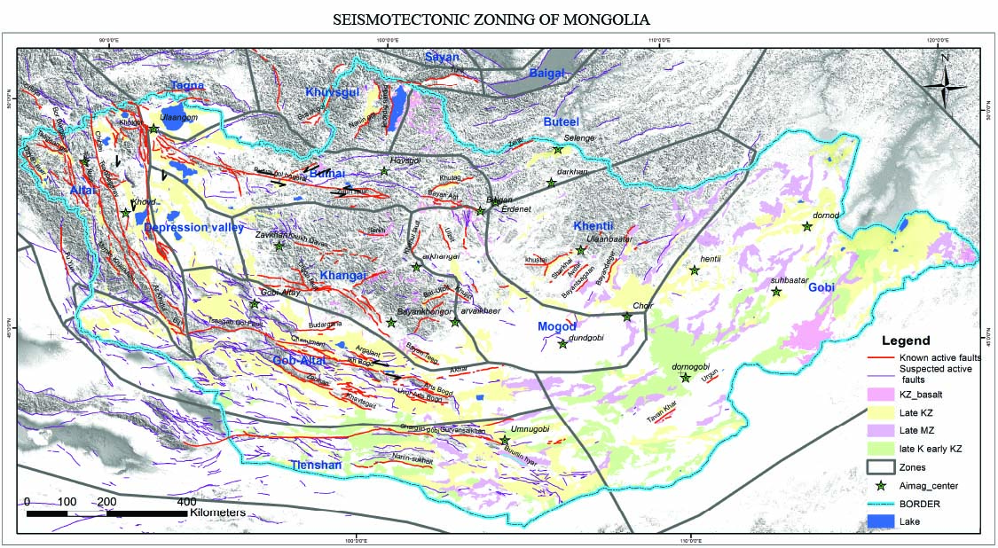
PRIORITIES
11
UNCERTAINTY ANALYSIS
11
The next gains will come from reducing model uncertainty
08
Source and recurrence uncertainties are included in the hazard calculation
1
Update catalogues
Consistent magnitudes and completeness
LOGIC-TREE PRIORITIES
1
Catalogue completeness
2
Expand fault evidence
Mapping, dating and segmentation
2
a–b parameter uncertainty
3
Maximum magnitude
3
Quantify alternatives
Logic-tree treatment of epistemic uncertainty
4
Zone and fault alternatives
4
Validate outputs
Compare hazard patterns with observations and new data
Alternative source assumptions are propagated through PSHA.
Catalogue completeness, recurrence parameters, maximum magnitude, and source geometry affect the calculated rates.
An updateable model is more valuable than a fixed map.
Source: Ankhtsetseg D., Odonbaatar Ch., Bayasgalan A., Demberel S., Baatarsuren G., Battogtokh D., Bayarsaikhan E., Dembereldulam M., Amarmend A., Dorjdavaa M, 2020, The preliminary seismotectonic map of Mongolia, Геофизик ба Одон орон судлал. N7, 25-37, 2020.
IAG Mongolia • ANSO–MAS 2026
IAG Mongolia • ANSO–MAS 2026

Slide 9
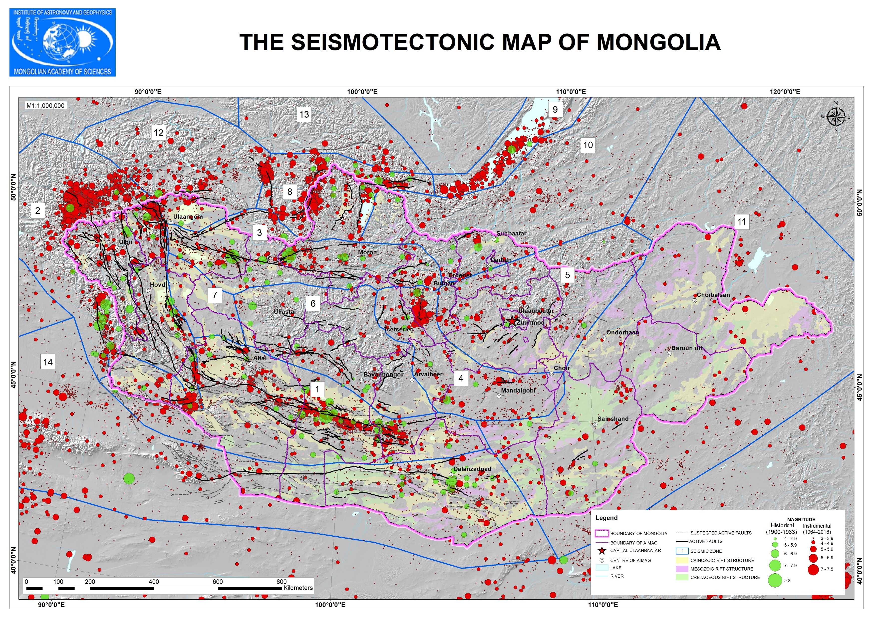
INTEGRATED SOURCE MODEL
08
INTEGRATED SOURCE MODEL
08
The current model combines 19 zones with ≈80 faults
09
Fourteen area zones and ~80 active fault sources form the national model
19
≈80
Integrated model
SEISMIC SOURCE ZONES
ACTIVE FAULT RUPTURE SOURCES
Area sources provide nationwide coverage.
Fault sources preserve localized rupture potential.
Their integration represents Mongolia’s observed seismicity and active tectonic setting.
Coverage
No region is left without a source representation.
This is the core scientific result.
Area zones follow seismicity and tectonic structure; fault sources require evidence of recent activity.
Source: Ankhtsetseg D., Odonbaatar Ch., Bayasgalan A., Demberel S., Baatarsuren G., Battogtokh D., Bayarsaikhan E., Dembereldulam M., Amarmend A., Dorjdavaa M, 2020, The preliminary seismotectonic map of Mongolia, Геофизик ба Одон орон судлал. N7, 25-37, 2020.
IAG Mongolia • ANSO–MAS 2026
IAG Mongolia • ANSO–MAS 2026

Slide 10
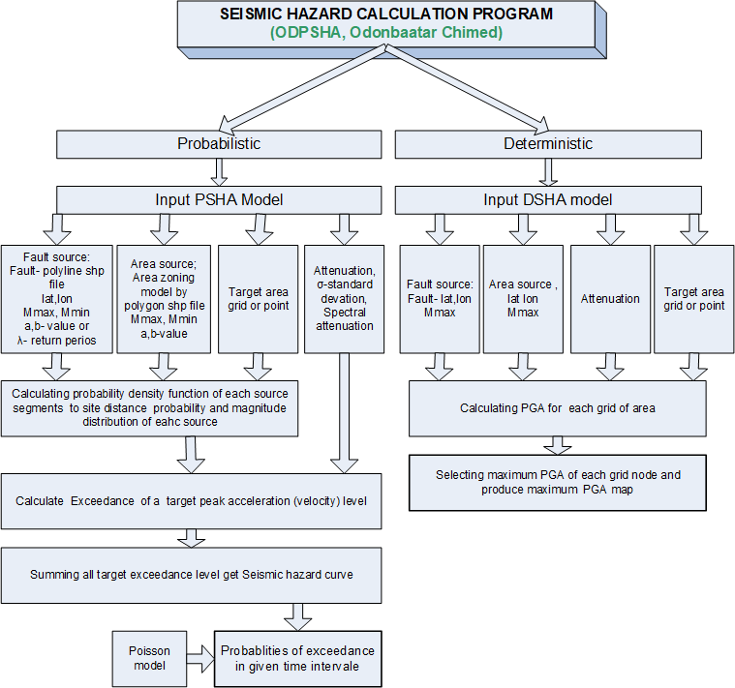
HAZARD CALCULATION
10
SOURCE MODEL
Geometry + rates
GROUND MOTION
GM models
INTEGRATION
All sources
HAZARD CURVE
Annual exceedance
MAPS
Design levels
IAG Mongolia • ANSO–MAS 2026
Source: ODPSHA program, Odonbaatar Chimed

Slide 11
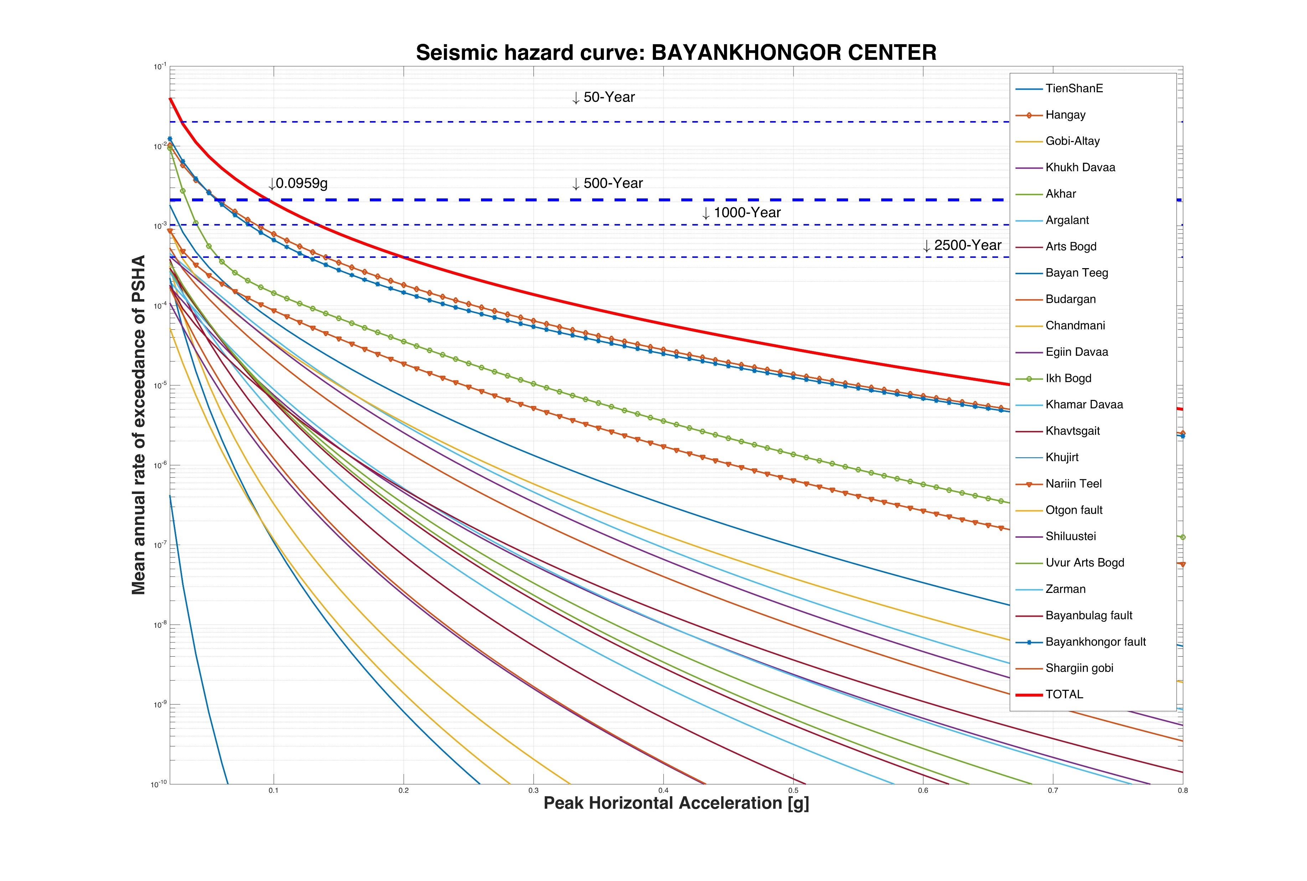
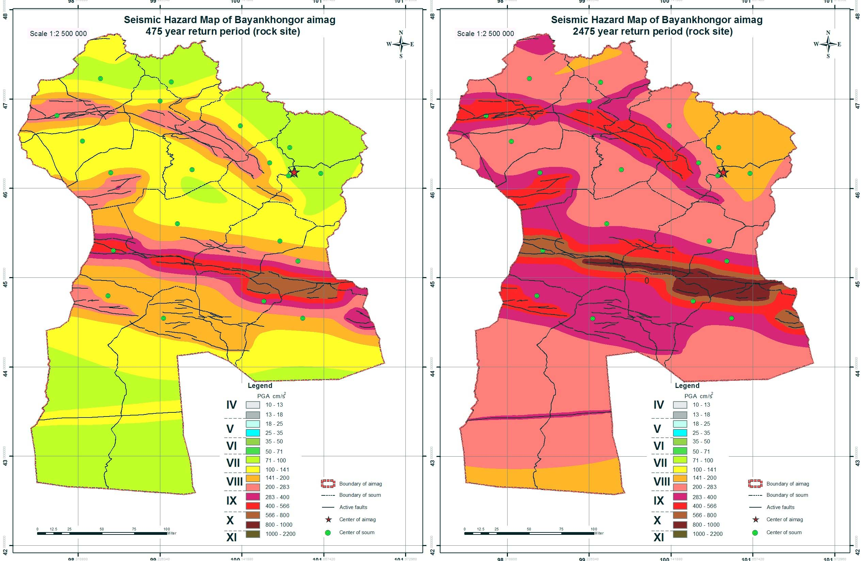
HAZARD CALCULATION
10
Source geometry and recurrence are integrated in PSHA:
Case study of Bayankhongor province
SOURCE MODEL
Software: ODPSHA
Geometry + rates
GROUND MOTION
GM models
INTEGRATION
All sources
HAZARD CURVE
Annual exceedance
MAPS
Output: probability that a ground-motion level is exceeded
at a site within a specified time period.
Design levels
Source: Ankhtsetseg D., Odonbaatar Ch., Mongonsuren D., Bayaraikhan E and Dembereldulam M “Probabilistic seismic hazard assessment for Bayankhongor aimag of Mongolia”, Proceedings of Mongolian Academy of Sciences, 2019, p.43-56
IAG Mongolia • ANSO–MAS 2026

Slide 12
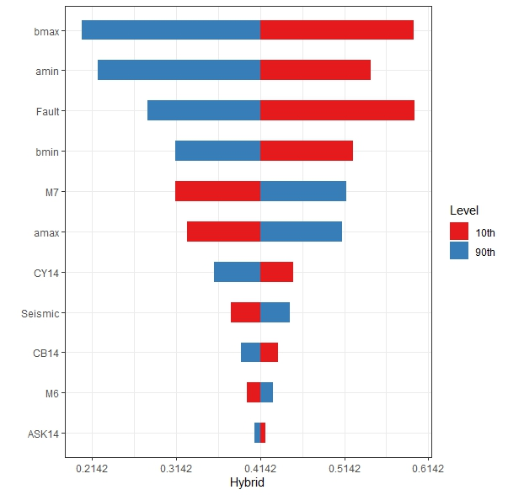
PRIORITIES
11
The next gains will come from reducing model uncertainty
1
Update catalogues
Consistent magnitudes and completeness
2
Expand fault evidence
Mapping, dating and segmentation
3
Quantify alternatives
Logic-tree treatment of epistemic uncertainty
4
Validate outputs
Compare hazard patterns with observations and new data
An updateable model is more valuable than a fixed map.
IAG Mongolia • ANSO–MAS 2026

Slide 13
RESILIENCE VALUE
The model provides input for design, planning, and preparedness
11
SAFER DESIGN
SMARTER INVESTMENT
BETTER PREPAREDNESS
Seismic design inputs and zoning
Infrastructure siting and prioritization
Disaster planning and risk communication
The model should be updated when new catalogue, fault, and geological data become available.
IAG Mongolia • ANSO–MAS 2026

Slide 14
The seismic source model of Mongolia
combines regional seismicity
with mapped active faults.
The area and fault seismic source zones
provide the source input for national PSHA.
Thank you • Questions
IAG Mongolia • ANSO–MAS 2026

